Slide 2
Overview of Tutorial
First chapter of Study Guide
Chapter 1 : Number Systems
1.1 Number Bases
1.2 Rational Numbers
1.3 Real Numbers
Subject Matter for Tutorial
Selected end of chapter revision questions
Selected past paper questions
Selected Questions from recommended texts
Also
Questions and Queries
Youtube videos listing at bit.ly/HibColl - The Discrete Maths listings
We will open the discussion now, and continue at the forthcoming onsite tutorial

Slide 3
Chapter 1: Number Systems
Four main number systems
Decimal (Base 10) (i.e. 0,1,2,3,4,5,6,7,8,9)
Binary (Base 2) (i.e. 0,1)
Hexadecimal (Base 16) (i.e. 0,1,……,8,9,A,B,C,D,E,F)
Octal (Base 8) (i.e. 0,1,2,3,4,5,6,7)
Key Objectives
Converting from one number system to another.
Performing arithmetic operations (e.g. binary addition and subtraction)

Slide 4
Conversion Tables
Dec | Bin | Hex | Dec | Bin | Hex
0 | 0 | 0 | 8 | 1000 | 8
1 | 1 | 1 | 9 | 1001 | 9
2 | 10 | 2 | 10 | 1010 | A
3 | 11 | 3 | 11 | 1011 | B
4 | 100 | 4 | 12 | 1100 | C
5 | 101 | 5 | 13 | 1101 | D
6 | 110 | 6 | 14 | 1110 | E
7 | 111 | 7 | 15 | 1111 | F

Slide 5
The Binary System
Task: Converting decimal numbers to binary
“Express the decimal number (347)10 in base 2”
Taken from 2010 Zone A Examination paper – Q1c (2 Marks)
Worked Example on Next Slide
Correct Answer - 101011011
Make a note of correct answer. I have a question at the end of the working!

Slide 6
Decimal to Binary Conversion
 | Number | Divided by 2 | Quotient | Remainder
1 | 347 | 173.5
2
3
4
5
6
7
8
9
10

Slide 7
Decimal to Binary Conversion
 | Number | Divided by 2 | Quotient | Remainder
1 | 347 | 173.5 | 173 | 1
2 | 173 | 86.5 | 86 | 1
3 | 86 | 43 | 43 | 0
4 | 43 | 21.5 | 21 | 1
5 | 21 | 10.5 | 10 | 1
6 | 10 | 5 | 5 | 0
7 | 5 | 2.5 | 2 | 1
8 | 2 | 1 | 1 | 0
9 | 1 | 0.5 | 0 | 1
10

Slide 8
The Binary System (1.1.2. pg 3)
Task: Converting binary numbers to decimal
“Express the binary number (1011.011)2 as a decimal, showing all your workings.”
Taken from 2010 Zone A Examination paper – Q1b (2 Marks)
Worked Example on Next Slide
Important points
Anything to the power of zero is 1.
“decimal points” are a type of “radix point” – specific to decimal numbers.
Demonstration of Negative Powers

Slide 9
Decimal to Binary Conversion
Number | Power of 2 | Component | Multiple
1 | 3 | 8
0 | 2 | 4
1 | 1 | 2
1 | 0 | 1
. | . | . | .
0 | -1 | 0.5
1 | -2 | 0.25
1 | -3 | 0.125
 |  | Total =

Slide 10
Binary Addition
Binary Addition - Fundamental Operations
All digits below are binary
Two Basic Operations
0 + 0 = 0
1 + 0 = 1 also 0 + 1 = 1
Two More Advanced Operations
1 + 1 = 10 ( i.e. 0 carry the 1)
1 + 1+ 1 = 11 ( i.e. 1 carry the 1)
Task: Carry out the following binary addition : 10101 + 11011
Taken from 2010 Zone A Q1a

Slide 11
Binary Addition ( part of 2010 Q1a)
1 | 0 | 1 | 0 | 1
1 | 1 | 0 | 1 | 1

Slide 12
Binary Subtraction
Use the concept of “borrowing”
Use basic operations from binary addition, but in reverse.
Important
10 - 1 = 1
Task: carry out the following binary addition : 110000 - 10111
Taken from Study guide Exercises Q5 pg 16
( Decimal Equivalent: 48-23)

Slide 13
Binary Subtraction
1 | 1 | 0 | 0 | 0 | 0
 | 1 | 0 | 1 | 1 | 1

Slide 14
Binary Subtraction (2nd Example)
1 | 1 | 1 | 0 | 1 | 0
 | 1 | 0 | 1 | 1 | 1

Slide 15
Binary Multiplication
Follows on from Binary Addition
Additional Skill : Left Shifting
Task: carry out the following binary addition : 1101 x 1101
Taken from Study guide Exercises Q5 pg 16
(Decimal Equivalent: 13 x 13 = 169)
(Correct Answer 10101001)

Slide 16
Binary Multiplication
 |  | 1 | 1 | 0 | 1
 |  | 1 | 1 | 0 | 1

Slide 17
Binary Multiplication
 | 1 | 0 | 0 | 0 | 1
 |  | 1 | 0 | 1 | 1

Slide 18
Binary Division
Follows on from Binary Subtraction
Task: carry out the following binary division : 111011 ÷ 101
Taken from Study guide Exercises Q7 pg 17
( Decimal Equivalent: 59 ÷ 5)

Slide 19
Binary Division
1 | 1 | 1 | 0 | 1 | 1

Slide 20
Hexadecimal Conversion
Convert a Hexadecimal to Decimal
Hex | Dec | Hex | Dec | Hex | Dec | Hex | Dec
0 | 0 | 4 | 4 | 8 | 9 | C | 12
1 | 1 | 5 | 5 | 9 | 9 | D | 13
2 | 2 | 6 | 6 | A | 10 | E | 14
3 | 3 | 7 | 7 | B | 11 | F | 15

Slide 21
Hexadecimal Conversion
Task: Converting hexadecimal numbers to decimal
Convert the number (A5d)16 to decimal form (Answer : 2653)
Based on Question 10, page 17
(Recall - anything to the power of zero is 1)
A x 16 + 5 x 16 + D x 16

Slide 22
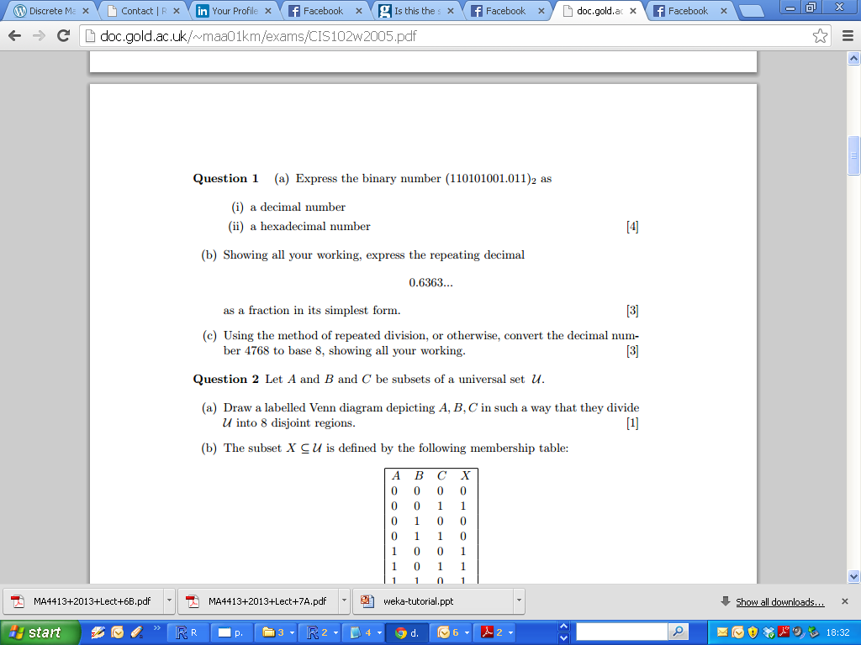
Exam Standard Question

Slide 23
Conversion Tables
Dec | Bin | Hex | Dec | Bin | Hex
0 | 0 | 0 | 8 | 1000 | 8
1 | 1 | 1 | 9 | 1001 | 9
2 | 10 | 2 | 10 | 1010 | A
3 | 11 | 3 | 11 | 1011 | B
4 | 100 | 4 | 12 | 1100 | C
5 | 101 | 5 | 13 | 1101 | D
6 | 110 | 6 | 14 | 1110 | E
7 | 111 | 7 | 15 | 1111 | F

Slide 24
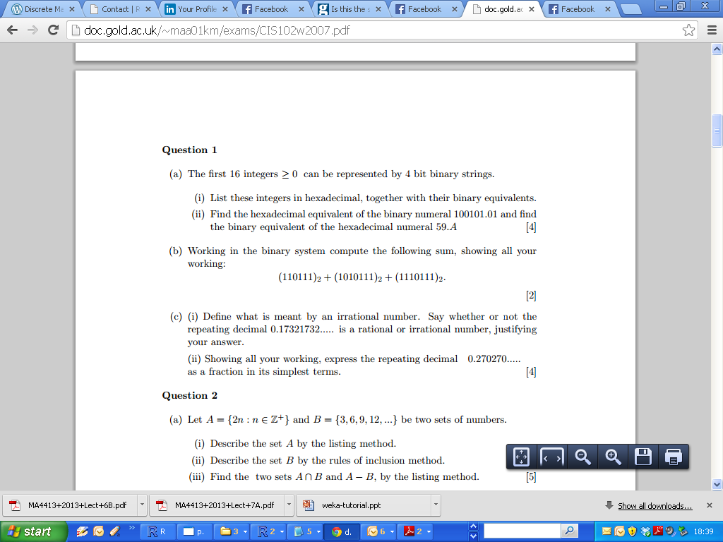
Exam Question 2007

Slide 25
Integers, Rational and Real Numbers
Integers
Rational Numbers (Quotients)
Real Numbers

Slide 26

Repeating Decimals

Slide 27
Repeating Decimals
X = 0.6363……

Slide 28
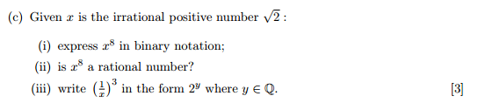
Rational and Irrational numbers

